Slide 1



Data Analyst Assignment: Call Data Analysis and Insights
Dive into the call data to uncover operational insights and optimize agent performance.
by Alok Panwar

Slide 2
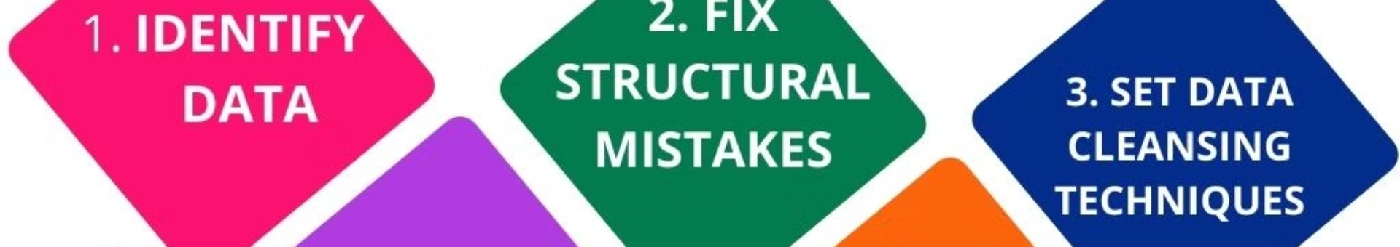
Data Preprocessing and Exploration
Cleansed and formatted the data, revealing key observations to inform the analysis.
1
Converted Date Columns
2
Handled Missing Values
3
Identified Data Quirks
Ensured consistency in date/time data formats.
Noted any unusual patterns or inconsistencies.
Addressed incomplete records to ensure data integrity.

Slide 3
Call Volume and Lead Metrics
Analyzed overall call activity, lead generation, and conversion rates.
Total Calls
Unique Leads
Conversion Rates
24494
8276
Leads converted: 3446
Leads Lost: 4907

Slide 4
Lead Disposition Analysis
Breakdown of call outcomes and opportunities for improvement.
Answered
Interested
12077
3446
Not Interested
Other Statuses
4907
4064

Slide 5

Agent Performance Metrics
Evaluating individual agent contributions and identifying training opportunities.
Calls Made
Leads Converted
24494
3446
1
2
3
Calls Connected
12077

Slide 6
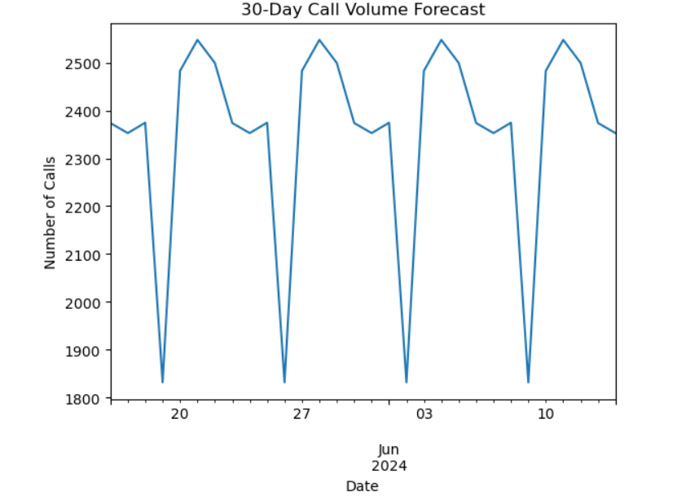



Call Volume Forecasting
Predict future call volumes to optimize staffing and resource allocation.
Forecasting Method
Exponential Smoothing for 30-day projections.
Projected Trends
Identify potential peaks and troughs in call volume.
Looks positive
Insights Gained
Optimize staffing and resource planning.
Numbers-2000+

Slide 7




Key Findings and Recommendations
Summarize insights and propose actions to drive operational improvements.
Broad Call Metrics
Conversion Optimization
Agent Performance
Forecasting Insights
Total calls-24494, leads-12077, and conversion rates-28%
Shadab Khan,
Wasim Khan made only 2,3 calls.
Nainsee Jaiswal
Mansi Jaiswal are top Agents in converting the leads .
Fired Agents that are making calls less than average and promote those who are top agents.

Slide 8
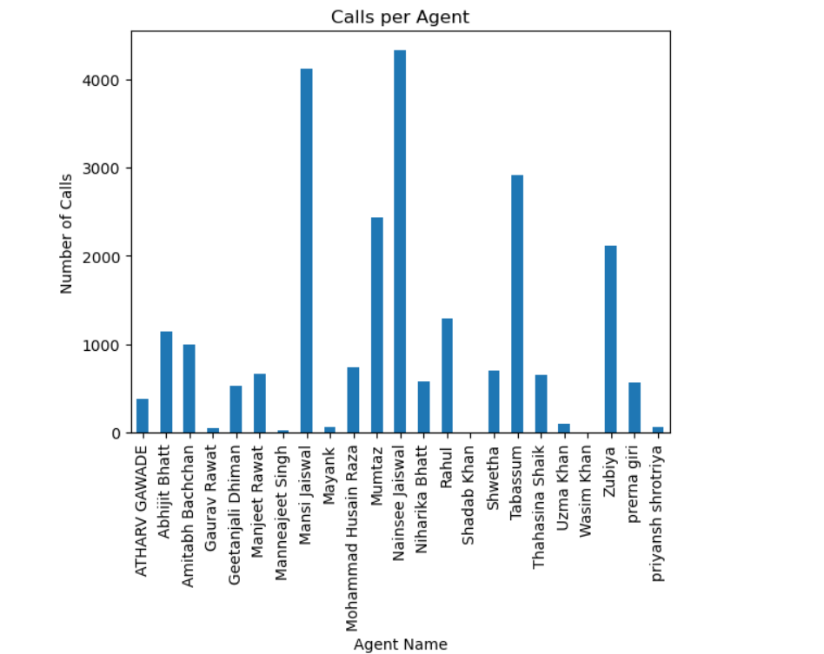
Putting Insights Into Action
Optimize Agent Training
Address Low Conversion Rates
Leverage Forecasting Insights
Identify top performers and areas for improvement
Proactively plan staffing and resource allocation
Tailor strategies for different call outcomes

Slide 9
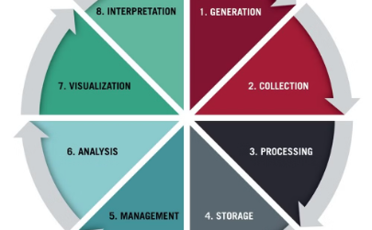
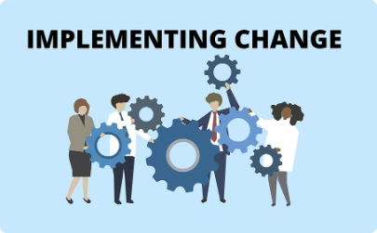
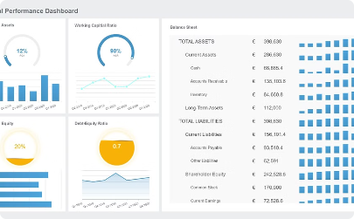
Continuous Improvement
Maintain a cycle of analysis, action, and monitoring for long-term success.
Analyze and Refine
Implement Strategies
Monitor Performance
Regularly review call data to uncover new insights.
Execute recommended actions to drive improvements.
Track KPIs and adjust plans based on results.

Slide 10

Thank You
For your time and attention.

